Slide 1
Notes:
Talking about ”Taking Linear Logic Apart”...
We’ll see what that means in a second.
Joint work with Fabrizio Montesi and Marco Peressotti, who couldn’t be here today, because they live in Denmark.

Slide 2
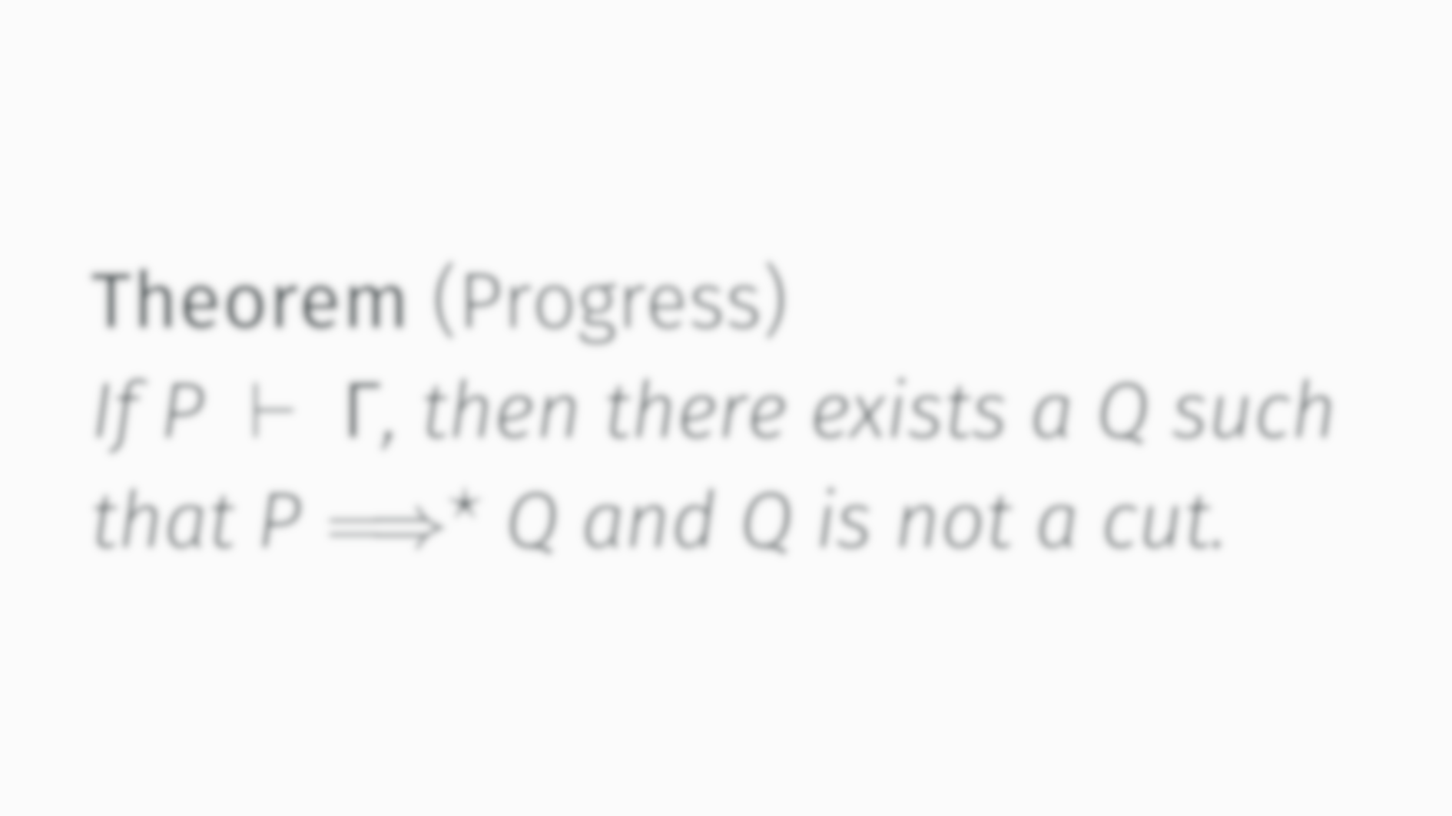
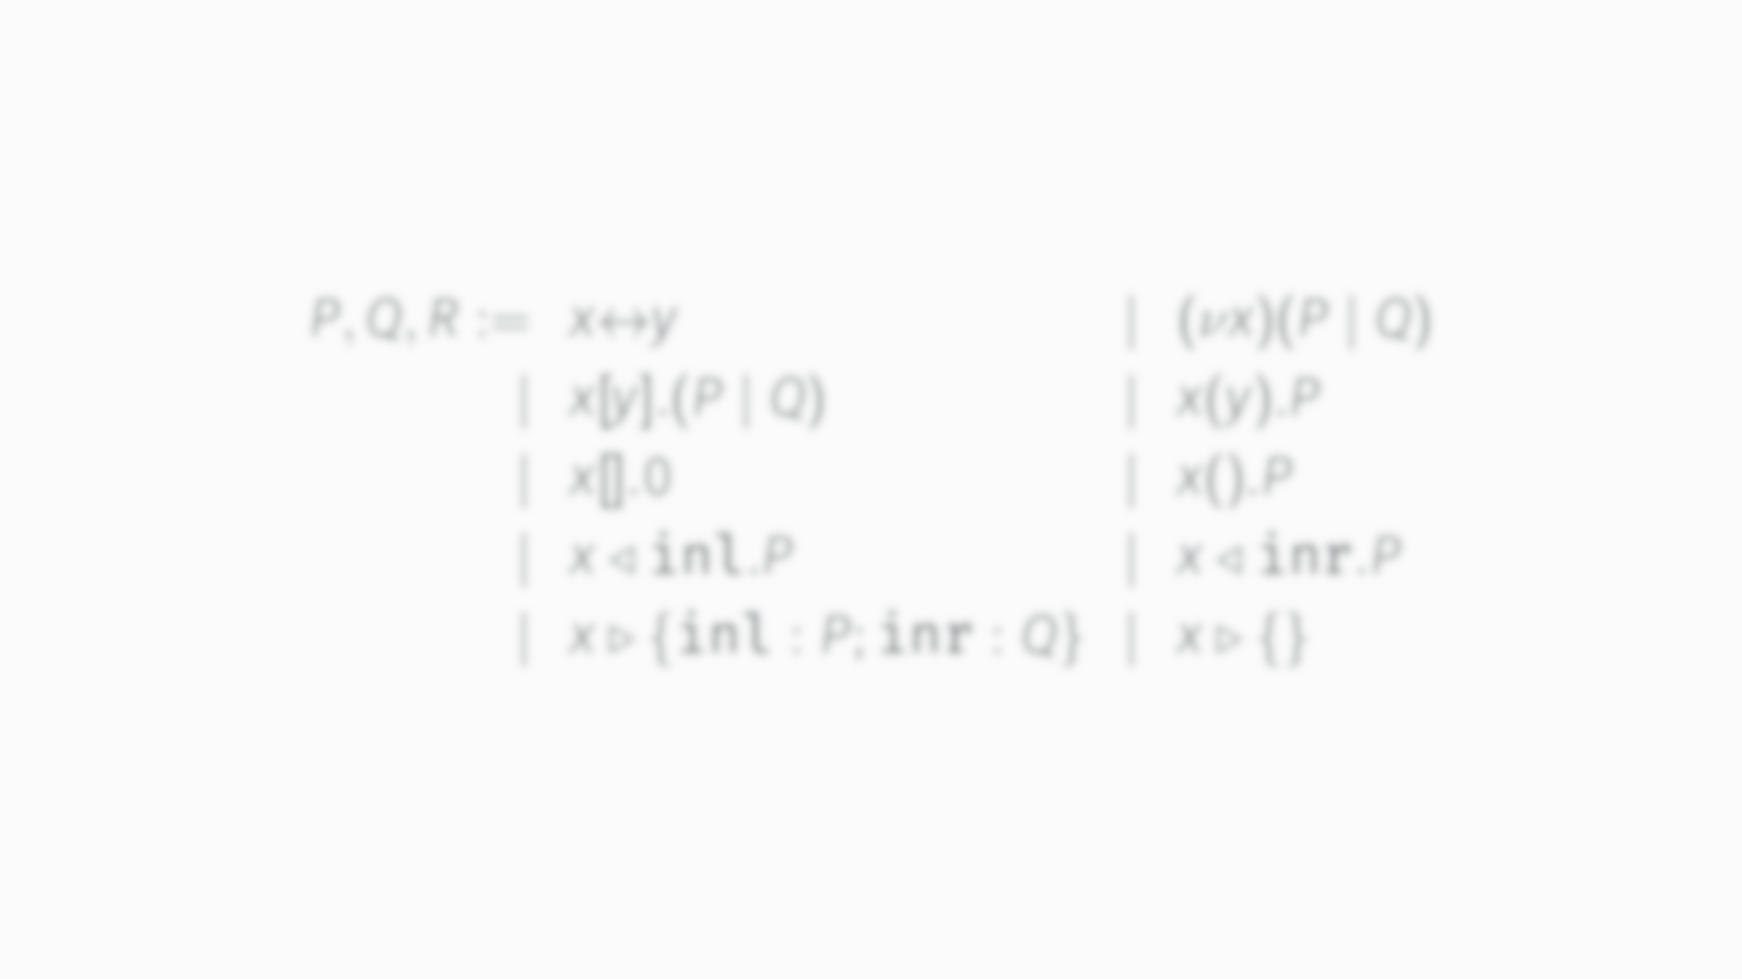
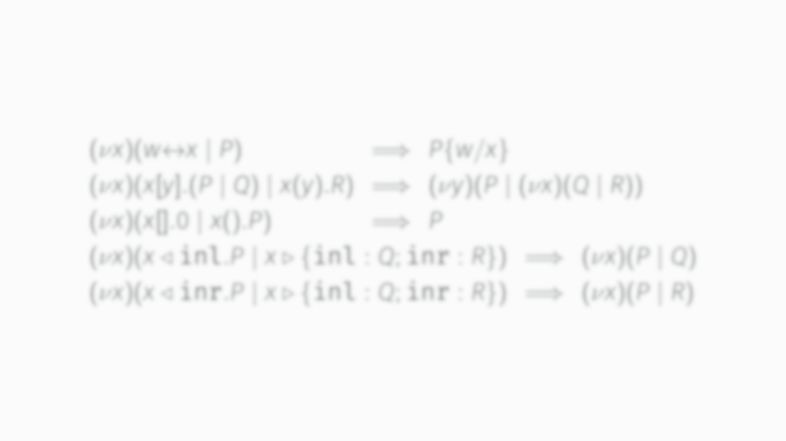

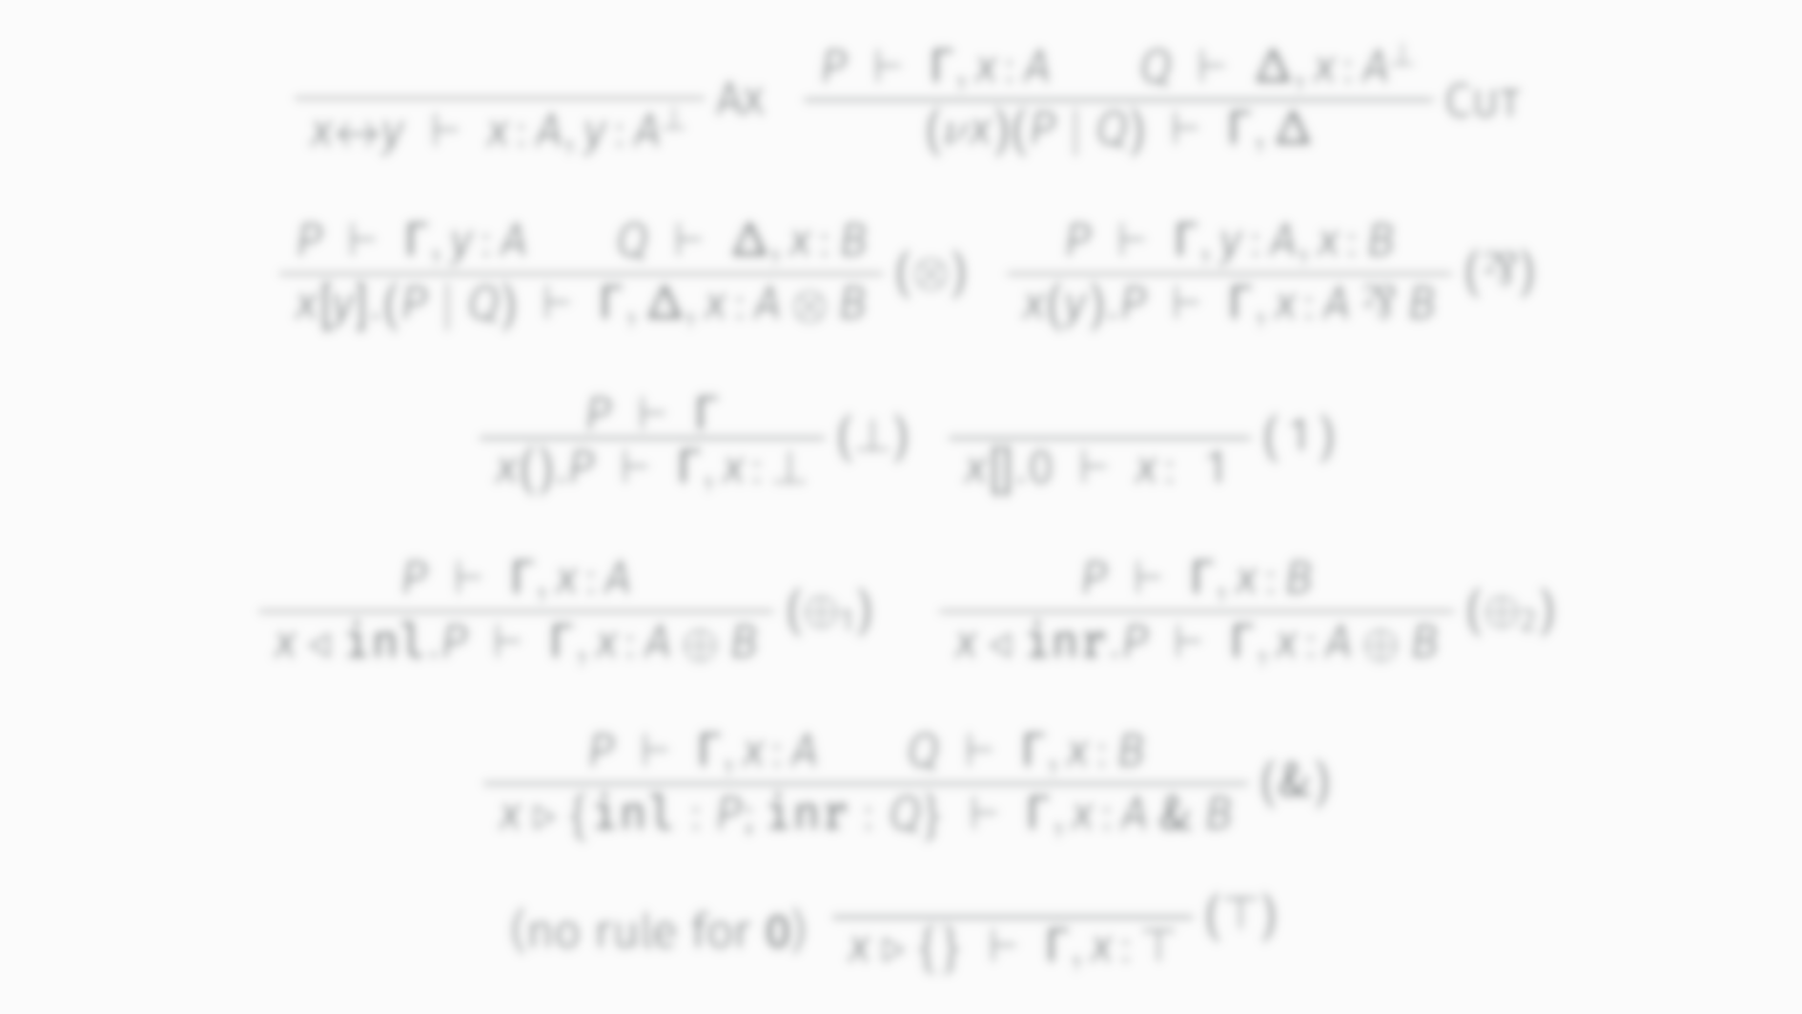
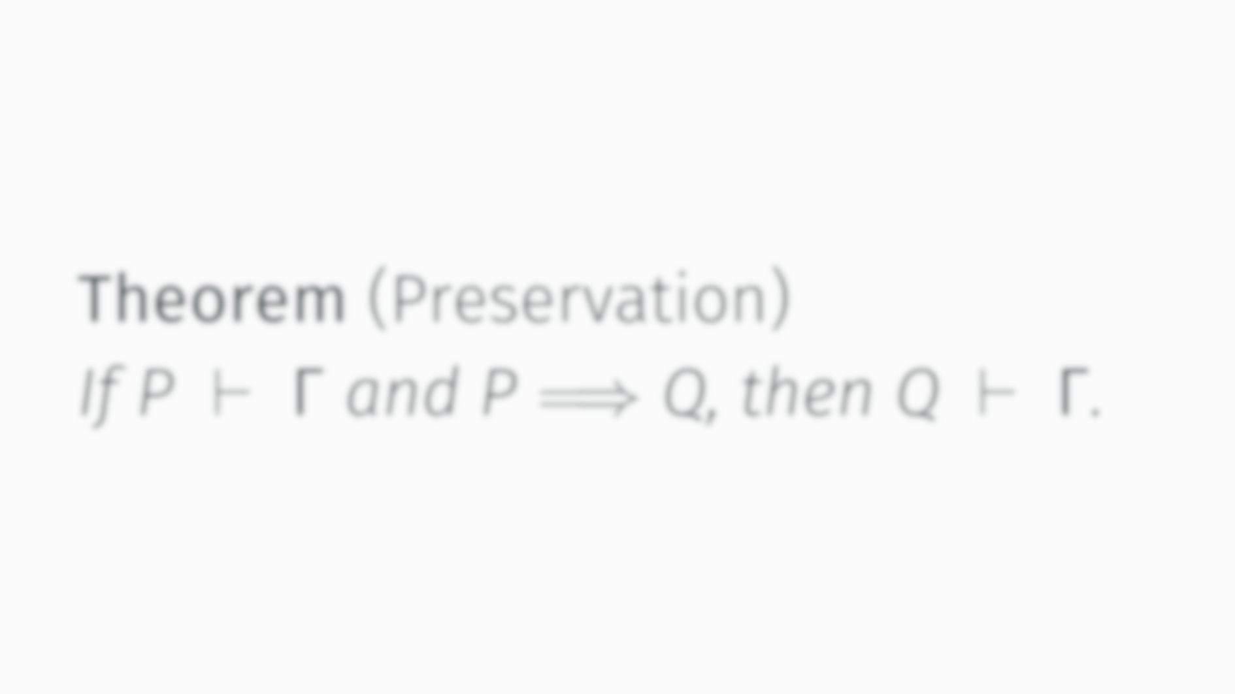
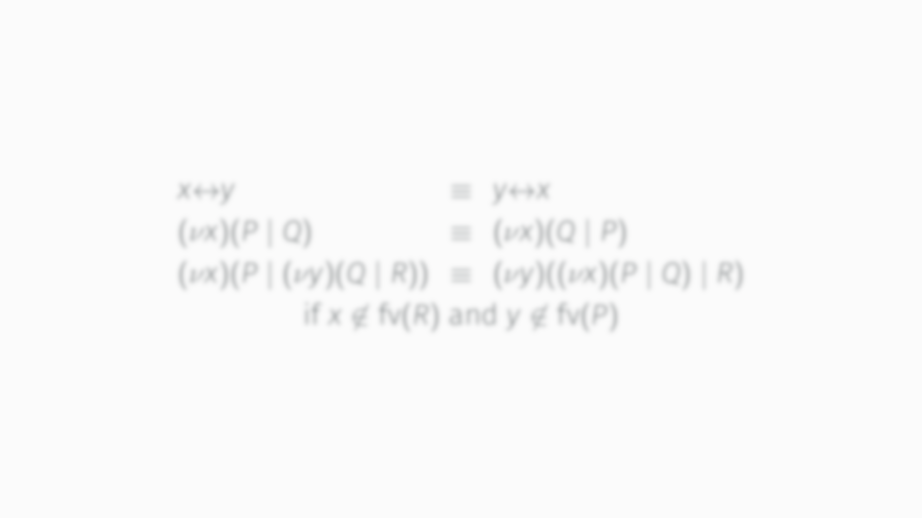
What will I talk about?
HCP, a variant of CP with
a nicer term language
the same nice properties
the same communication protocols
Equivalences
(on terms)
Reductions
(also on terms)
Types
(for channels)
Typing rules
(associating processes with the types of their channels)
Terms
Theorems
More theorems
(actually, no, let’s talk about this one)
Read: there are no deadlocks

Slide 3
Start with an example, please!

Slide 4
}
That’s me!
}
Gives you access
to the email I wrote
For future
communication
That’s the email I wrote
That’s my supervisor
That’s me, going climbing...
That’s me, doing some more work...
That’s me, doing whatever...
Notes:
So... Like all good presentations, let’s start with an example... In this case, me, sending an email, to my supervisor! We’re writing in CP, which is a process calculus with a strong correspondence to linear logic.
So... That’s me!
And that’s my supervisor...
That’s the email I wrote...
And that’s me, continuing to do some work after I send the email...
Or going climbing...
Or doing whatever... The point is, we don’t really care about what I do after I send the email...
So that “y”, that’s a channel which gives you access to the email. In essence, what I’m doing when I write an email is, I’m forking off a process which represents the data of the email, and then I’m giving my supervisor access to it...
And that “x”, well, that’s for future communication with me....

Slide 5
So what’s the problem?
So what’s this cruft?
It says that
we’re sending a fresh communication channel; and
we continue as two processes living in parallel.
It says that
we’ve got a shared communication channel; and
we’re processes living in parallel.
Notes:
There’s one bit of syntax which we haven’t addressed yet.
What’s this cruft?
We’ll, it says that we’ve got a shared communication channel called “x”, and that we’re two processes living in parallel.
What’s the problem with this?
That’s the problem with this. This thing is a single, atomic construct, but it’s doing two different jobs! And actually, we have another one of those...
This send construct tells us that we’re sending “y” over “x”, but it also tells us that we continue as two independent parallel processes!

Slide 6
Notes:
If we look at the term syntax for CP, we see that there’s actually three of these things. That third one sends a ping and halts. Makes for less interesting examples. Anyway... We’ve got all these atomic constructs that do one thing and another thing. And to make matters worse, for two of them, that second thing is the same.
So... We’d rather have something like this. Where we have a single construct for parallel composition. And every atomic construct really only does one thing.

Slide 9
So what about types?

Slide 10
“send A and continue as B”
“receive A and continue as B”
(names have to be unique)

Slide 11
Whatever the future holds?
(out of scope for this example)
IMAP session
Email Server
(which has the email I sent)

Slide 12
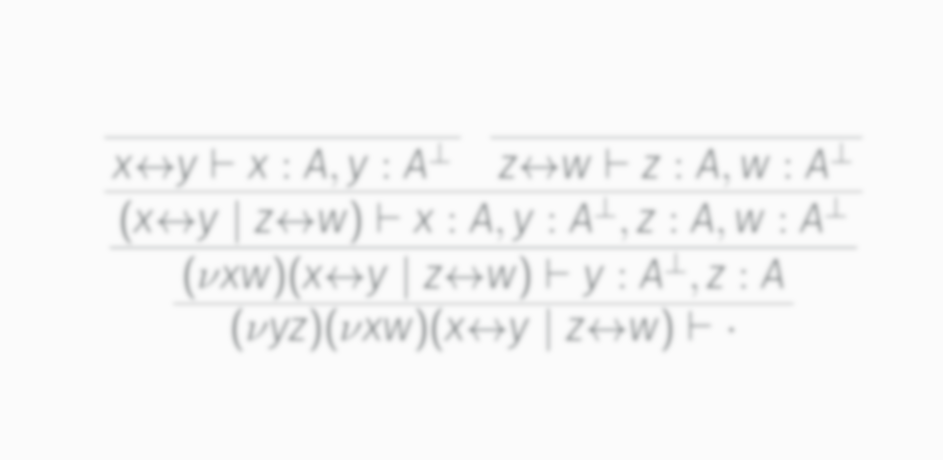
x
w
y
z
(we have to use this new syntax for now)

Slide 13
P
Q

Slide 14
P
Q
R

Slide 15
(
we can connect the two end points of x
but only if they’re in different environments
and we have to merge those environments
)
(
we can put P and Q together
but let’s remember
the channels in the environments in 𝒢 and ℋ are not yet connected
)
uh, no?

Slide 16
can we do this when there is an x somewhere in 𝒢?

Slide 17
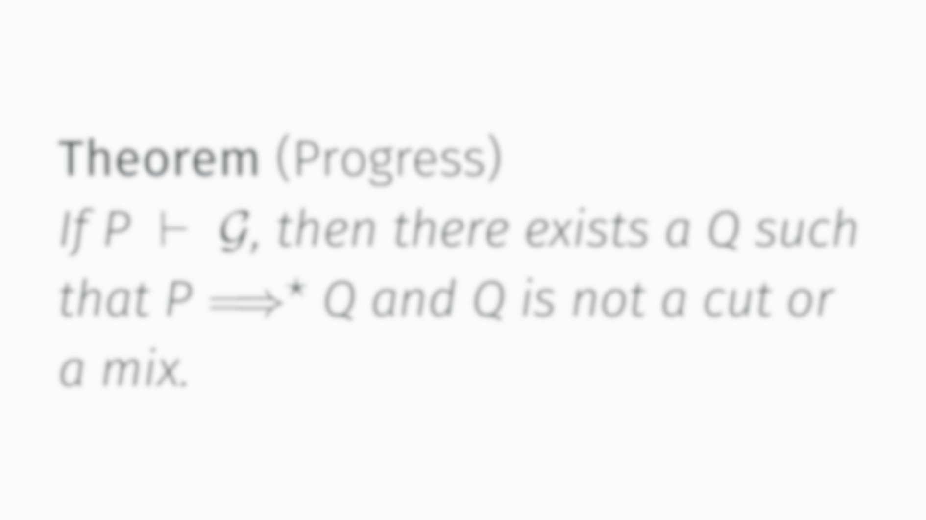
Read: there are no deadlocks

Slide 18
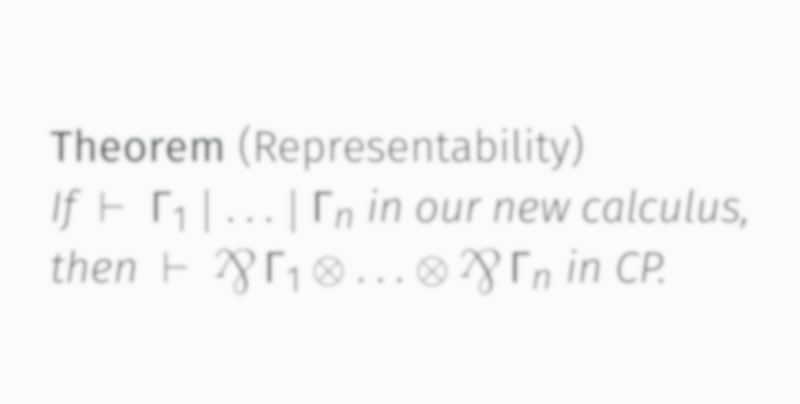
Read: our new calculus supports the
same communication protocols

Slide 19
So why is HCP better than CP?
has a nicer term language
keeps preservation and progress
(and thus deadlock freedom)
supports the same communication protocols
(see wenkokke.github.io/hcp)

